Slide 1

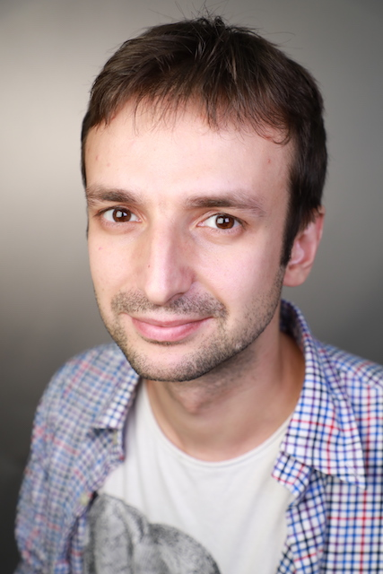

Deterministic Fully Sparse Matrix Multiplication via Coding Theory
Karthik Gajulapalli (Georgetown)
Huck Bennett
Sasha Golovnev
Evelyn Warton

Slide 2
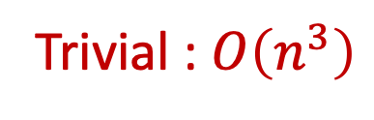
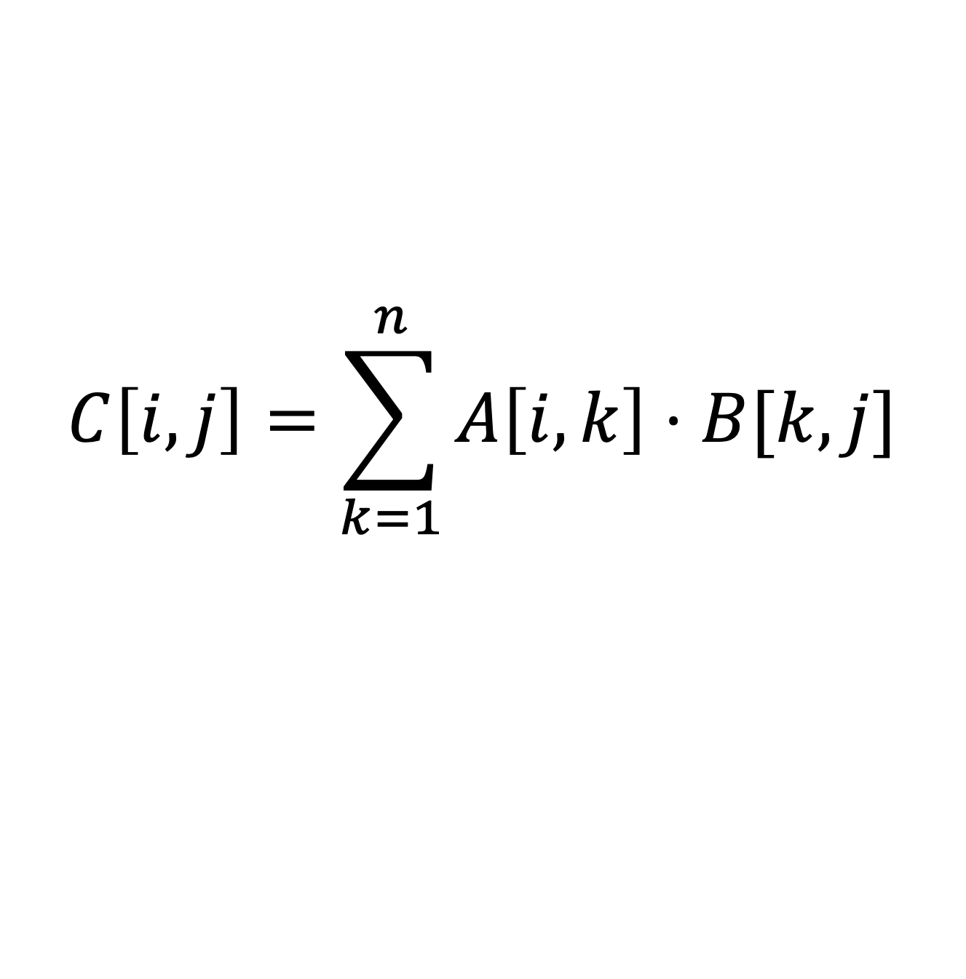
Matrix Multiplication (MM)
A
B
C
$$C\left[i,j\right]=\sum_{k=1}^{n}{A\left[i,k\right]⋅B[k,j]}$$
Trivial : $O\left(n^{3}\right)$

Slide 3



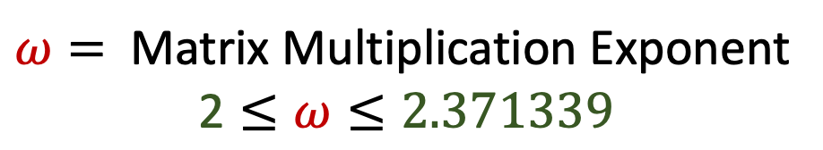



Fast MM
$ω=$ Matrix Multiplication Exponent
$$\text{2}≤ω≤2.371339$$
Year
$ω$
Authors
1857
$3$
Cayley
1969
$$2.8074$$
Strassen
1981
$$2.522$$
Schönhage
1981
$$2.496$$
Coppersmith, Winograd
1986
$$2.479$$
Strassen

Slide 4
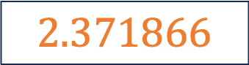

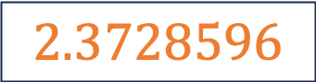
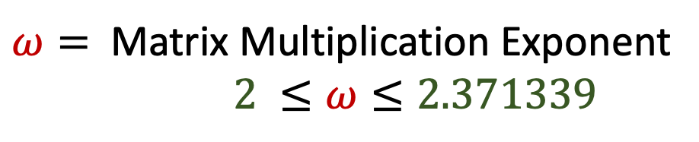
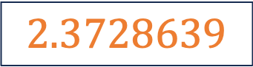

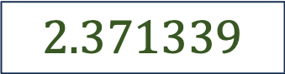
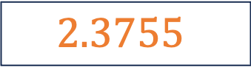
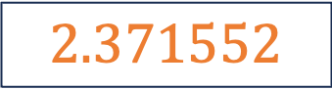
Fast MM
$ω=$ Matrix Multiplication Exponent
$2 ≤ω≤2.371339$
Year
$ω$
Authors
1990
$$2.3755$$
Coppersmith, Winograd
2012
$$2.3729$$
Vassilevska Williams
2014
$$2.3728639$$
Le Gall
2020
$$2.3728596$$
Alman, Williams
2022
$$2.371866$$
Duan, Wu, Zhou
2024
$$2.371552$$
V. Williams, Xu, Xu and Zhou
2024
$$2.371339$$
Alman, Duan, V. Williams, Xu, Xu and Zhou

Slide 5


Slide 6
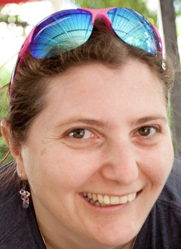



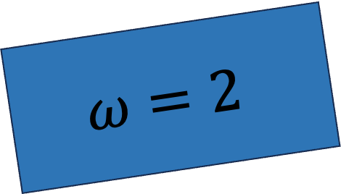
$$ω=2$$

Slide 7
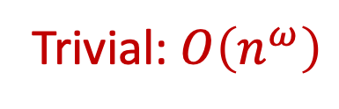
Matrix Multiplication Verification (MMV)
A
B
C
Input: A, B, C
Output : True if AB = C
Trivial: $O\left(n^{ω}\right)$

Slide 8

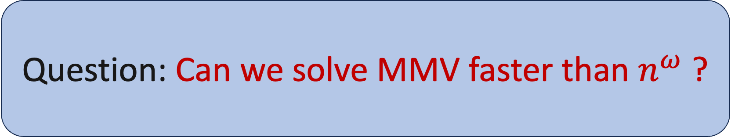
Question: Can we solve MMV faster than $n^{ω}$ ?

Slide 9

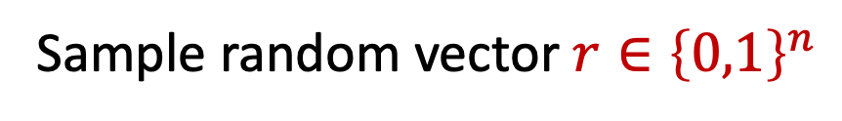
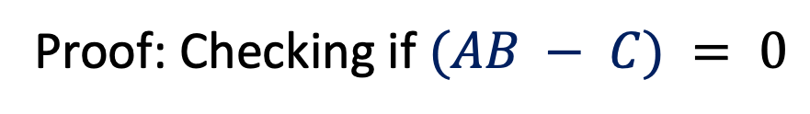
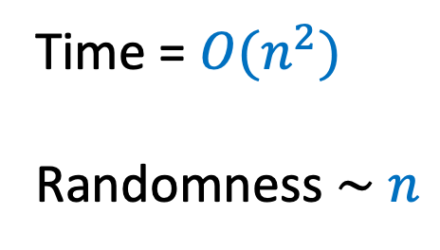
Freivalds’ Algorithm [1979]
A
B
r
C
r
Sample random vector $r∈{\left\{0,1\right\}}^{n}$
Time = $O(n^{2})$
Randomness $\sim$ $n$
Check if $ABr=Cr$
Proof: Checking if $(AB − C) = 0$

Slide 10
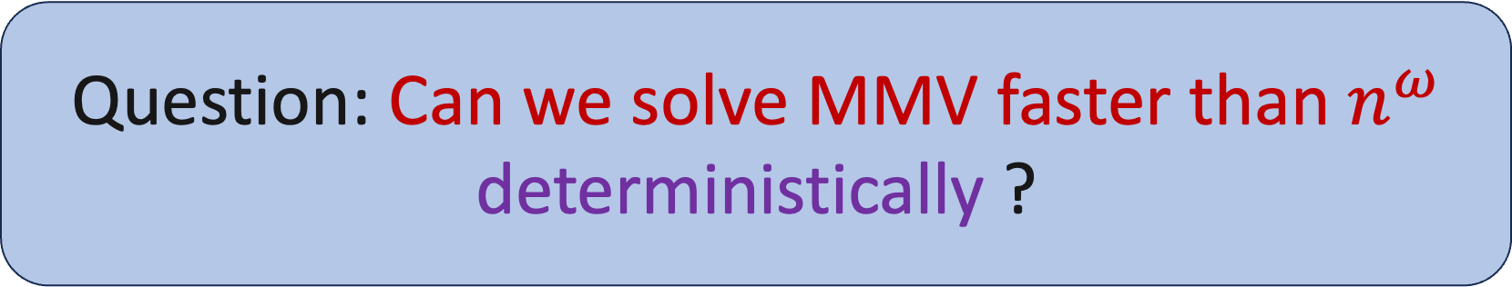
Question: Can we solve MMV faster than $n^{ω}$ deterministically ?

Slide 11
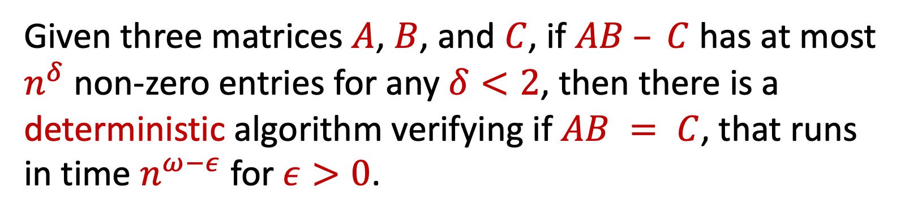
Theorem 1 [Fast Deterministic MMV]
Given three matrices $A$, $B$, and $C$, if $AB – C$ has at most $n^{δ}$ non-zero entries for any $δ<2$, then there is a deterministic algorithm verifying if $AB = C$, that runs in time $n^{ω−ε}$ for $ε>0$.

Slide 12
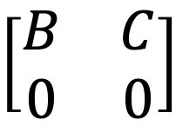
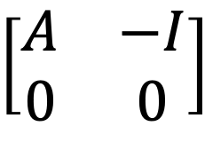
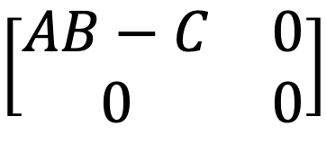
Helper Problem (All-Zeroes)
A
B
0
Input: A, B
Output : True if AB = 0
All-Zeroes = MMV
$$\left[\begin{matrix}A & −I \\ 0 & 0\end{matrix}\right]$$
$$\left[\begin{matrix}B & C \\ 0 & 0\end{matrix}\right]$$
$$\left[\begin{matrix}AB−C & 0 \\ 0 & 0\end{matrix}\right]$$
＝

Slide 13
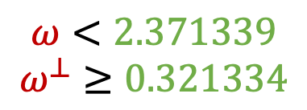
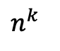
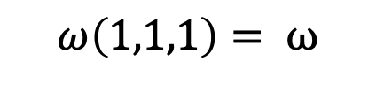
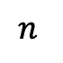
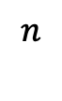
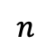
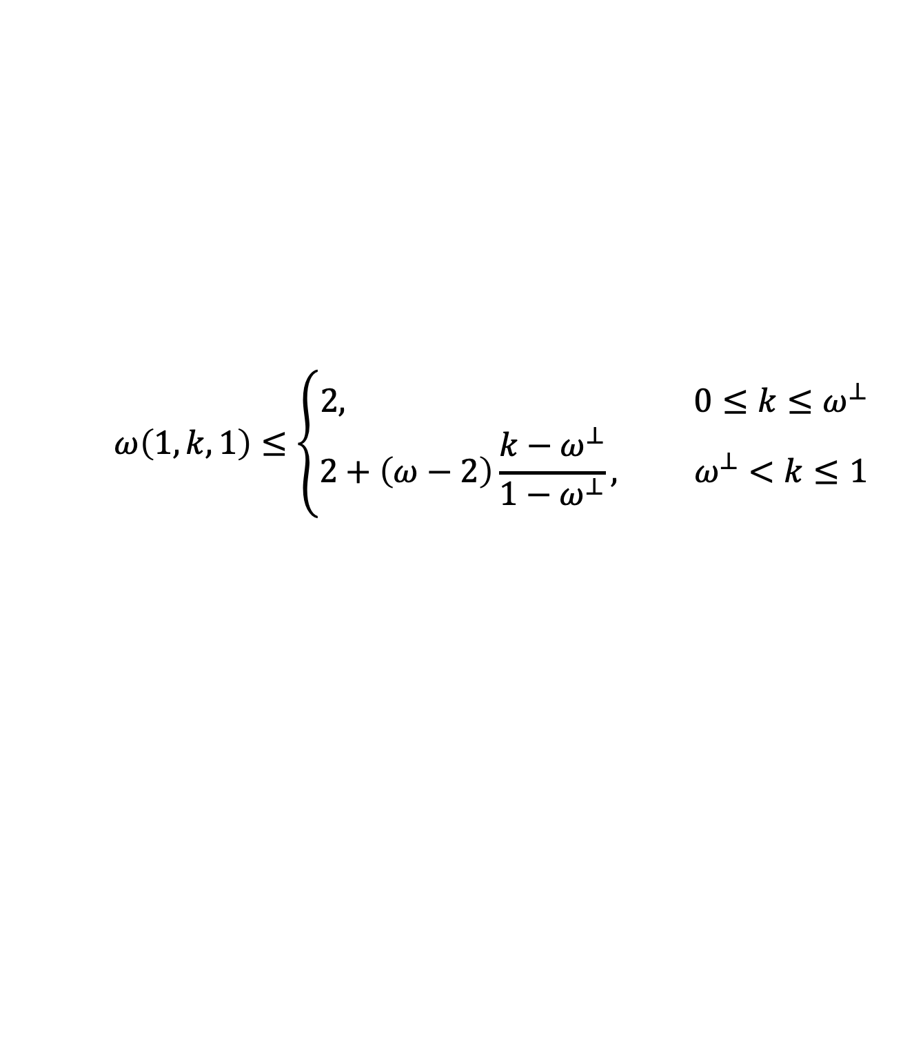
Fast Rectangular MM
$$ω<2.371339$$
$$ω^{⊥}≥0.321334$$
$$n$$
$$n^{k}$$
$$ω\left(1,1,1\right)= ω$$
$$n$$
$$ω\left(1,k,1\right)≤\left\{\begin{aligned}2, 0≤k≤ω^{⊥} \\ &2+\left(ω−2\right)\frac{k−ω^{⊥}}{1−ω^{⊥}}, ω^{⊥}<k≤1\end{aligned}\right.$$
$$n$$

Slide 14
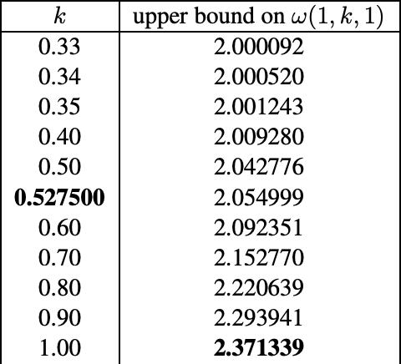
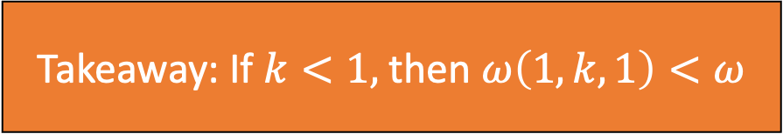
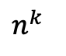
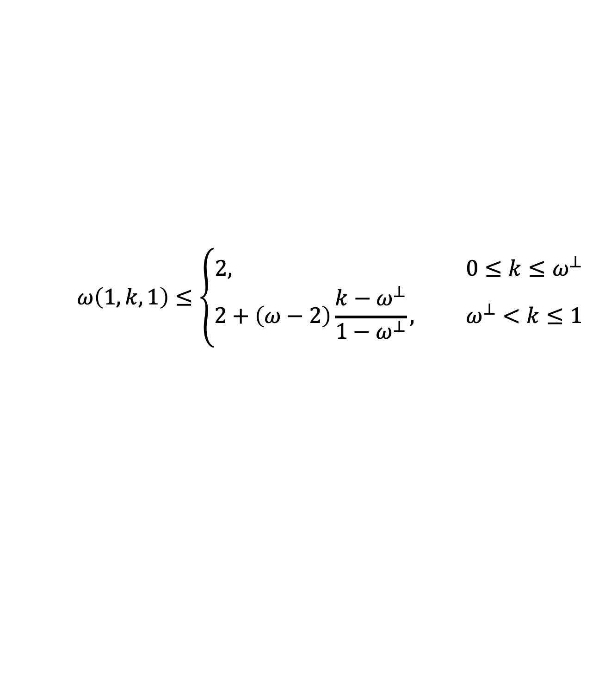
Fast Rectangular MM
$$ω<2.371339$$
$$ω^{⊥}≥0.321334$$
Takeaway: If $k<1,$ then $ω\left(1,k,1\right)<ω$
$$n$$
$$n^{k}$$
$$ω\left(1,k,1\right)≤\left\{\begin{aligned}2, 0≤k≤ω^{⊥} \\ &2+\left(ω−2\right)\frac{k−ω^{⊥}}{1−ω^{⊥}}, ω^{⊥}<k≤1\end{aligned}\right.$$
$$n$$
$$n$$

Slide 15
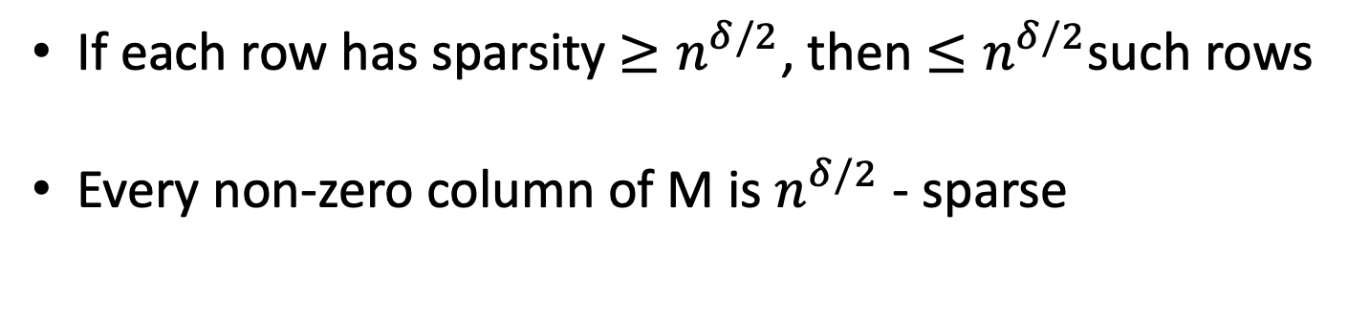
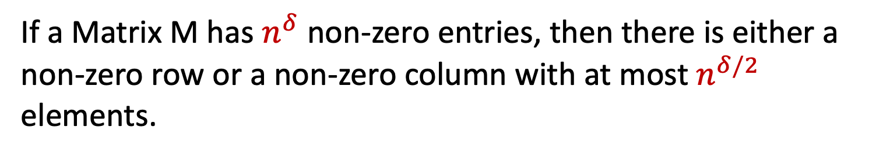
Lemma on Sparse Matrices
Lemma (Sparse Matrix Lemma):
If a Matrix M has $n^{δ}$ non-zero entries, then there is either a non-zero row or a non-zero column with at most $n^{δ/2}$ elements.
If each row has sparsity $≥n^{δ/2}$, then $≤n^{δ/2}$such rows
Every non-zero column of M is $n^{δ/2}$ - sparse

Slide 16
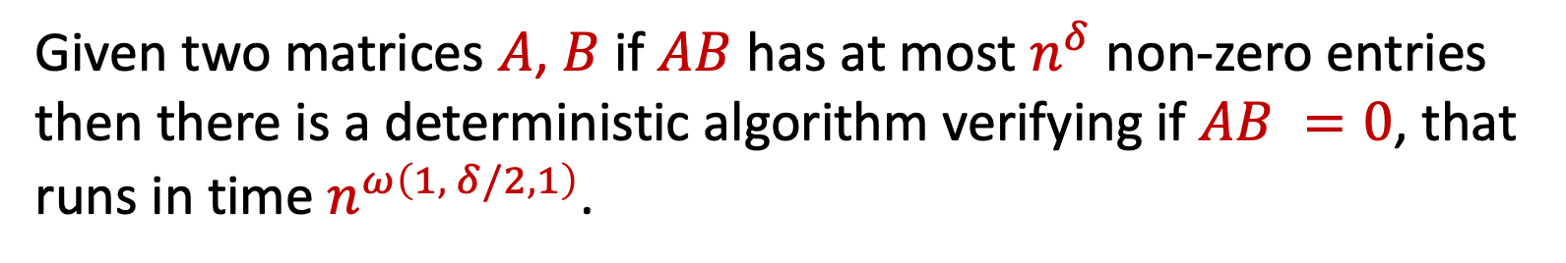
Fast Deterministic MMV
Theorem 1 [Fast Deterministic All-Zeroes]
Given two matrices $A$, $B$ if $AB$ has at most $n^{δ}$ non-zero entries then there is a deterministic algorithm verifying if $AB =0$, that runs in time $n^{ω\left(1, δ/2,1\right)}$.
By sparse matrix lemma we are promised existence of sparse row/col
Question: Can we detect a $n^{δ/2}$-sparse row/col efficiently?

Slide 17
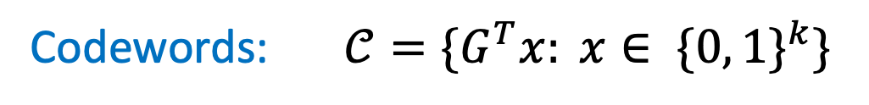
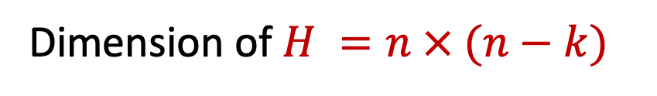
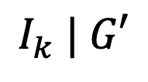
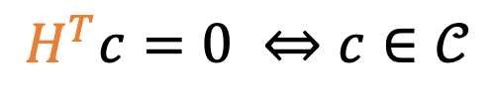
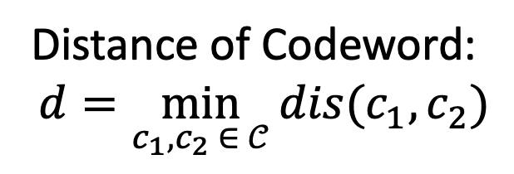
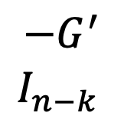
Quick Review of Linear Codes
Goal: Encode message of length k using n bits
Distance of Codeword:
$$d=\min_{c_{1},c_{2} ∈ 𝒞}{dis(c_{1},c_{2})}$$
Generator Matrix: G =
$$I_{k} | G′$$
Codewords:$𝒞={\{G}^{T}x: x∈ \{0, 1\}^{k}\}$
Code is MDS if d = n – k + 1
$$−G^{′}$$
$$I_{n−k }$$
Parity Check Matrix: H =
Dimension of $H =n × (n−k)$
$$H^{T}c=0 ⇔c∈𝒞$$

Slide 18
Linear Codes a Visual Experience
G

Slide 19
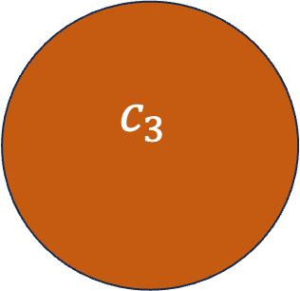
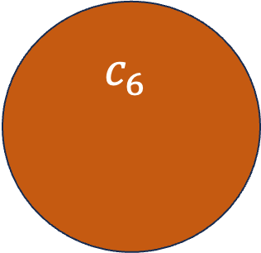
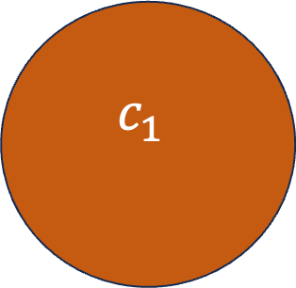
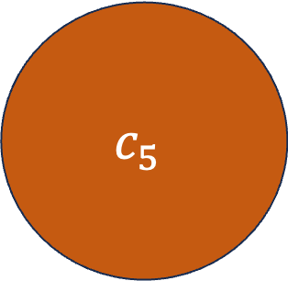
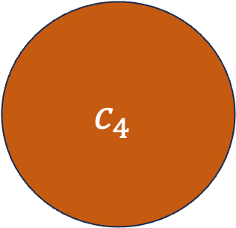
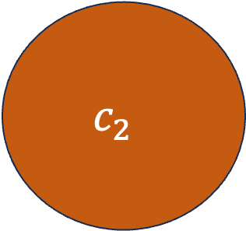
$$c_{1}$$
$$c_{6}$$
d
$$c_{3}$$
d/2
$$c_{2}$$
$$c_{5}$$
$$c_{4}$$

Slide 20
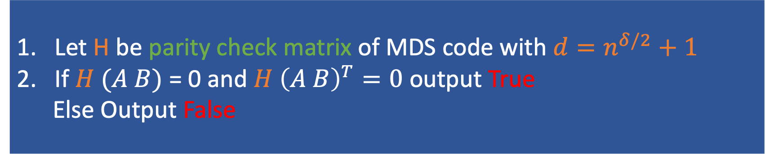
Detecting Sparse Row via MDS code
Let H be parity check matrix of MDS code with $d=n^{δ/2}+1$
If $H (A B)$ = 0 and $H {\left(A B\right)}^{T}=0$ output True
Else Output False
Any $n^{δ/2}$ sparse column cannot be a codeword, since $dis\left(0^{n}, col\right)≥n^{δ/2}+1$
So if column from sparse lemma is non-zero than H(AB) is non-zero

Slide 21




Running Time
Let H be parity check matrix of MDS code with $d=n^{δ/2}+1$
If $H (A B)$ = 0 and $H {\left(A B\right)}^{T}=0$ output True
Else Output False
Can generate H in $O\left(n^{2}\right)$
Dimension of $H = n ×{ n}^{δ/2}$
One possible H is Vandermonde Matrix = $\left[\begin{matrix}\begin{aligned}1 \\ x_{1}\end{aligned} & \begin{aligned}… \\ …\end{aligned} & \begin{aligned} 1 \\ x_{n}\end{aligned} \\ ⋮ & ⋱ & ⋮ \\ x_{1}^{d−1} & ⋯ & x_{n}^{d−1}\end{matrix}\right]$

Slide 22




Running Time
Let H be parity check matrix of MDS code $𝒞$with $d=n^{δ/2}+1$
If $H^{T} (A B)$ = 0 and $H^{T} {\left(A B\right)}^{T}=0$ output True
Else Output False
Fast Rectangular MM
$ω\left(1, δ/2, 1\right)<ω$ when $δ<2$
$$H\left(A B\right)=\left(HA\right)B$$
Running Time: $O(n^{ω(1,δ/2,1)})$

Slide 23



MMV is also hay in the hay stack
Kunneman[18] first showed that if AB-C is $n^{1.36}$-sparse you can beat naïve MM
We now show that this is true even when AB-C is $n^{1.999999}$-sparse
Hardest case when AB-C has $εn^{2}$ non-zeros
But this case has O(n) black-box randomized algorithm!!!!!

Slide 24


Slide 25

Open Question:
Input: Given A, B and the following promise:
Case 1: AB = 0
Case 2: AB has $εn^{2}$ non-zero entries
Output: Distinguish Case 1 from Case 2

Slide 26

Question: Can we use these ideas to solve MM in the sparse case?

Slide 27


Fast Deterministic Output-Sparse MM
Theorem 3 [Fast Deterministic Output-Sparse MM]
Given two matrices $A$, $B$ if $AB$ has at most $n^{δ}$ non-zero entries then there is a deterministic algorithm that computes $AB$, and runs in time $n^{ω\left(1, δ/2,1\right)}$.
Fast randomized algorithm for osMM in $n^{ω(1, 1, δ−1)}$
[Abboud, Bringmann, Fischer, Kunnemann SODA 24]

Slide 28


Inspiration from Compressed Sensing
Input: Parameters $m, n, t$
$$m ≤ n$$
Find: Compression matrix $H$ ($m × n$), Recovery algorithm $ℛ$
Guarantee: Given any $t$-sparse vector $e$, $ℛ\left(He\right)=e$
1
n
1
H
s
m
e
n
m

Slide 29





Special Case: Every column of AB is sparse
Construct $H$ for compressed sensing
Compute $HAB$
Output$C= ℛ(HAB)$
$T_{1}(n)$ : Running time to construct $H$
$T_{2}(n)$: Running time of Recovery algorithm $ℛ$
Let $m = n^{k}$, where $k∈[0,1]$
$$O(T_{1}\left(n\right)+n^{ ω(k, 1, 1)}+ {n T}_{2}\left(n\right))$$

Slide 30




WLOG all columns are sparse
Assume $AB$ is $n^{δ}$ sparse
$C’ = ℛ(HAB)$
$D =ℛ({\left(HAB – HC’\right)}^{T})$
Output ${C= D}^{T} + C’$
Claim:
At most $n^{δ/2}$cols with sparsity > $n^{δ/2}$, so only those cols will be non-zero in AB – C’
$$D^{T} = AB – C’$$
So every row in AB – C’ is $n^{δ/2}$sparse
Only need 2 passes !!!!

Slide 31

Achieving Compressed Sensing via Coding Theory
Theorem [Compressed Sensing via Coding Theory]
If there is a good linear error-correcting code (n, m, t) then:
There exists an efficient compressed sensing scheme for any t-sparse vector where:
$H$ is a matrix of dimension $(2t × n)$
$H$ can be computed in $O(n^{2})$ time
$ℛ$ runs in O(n) time

Slide 32

Achieving Compressed Sensing via Coding Theory
Good Linear Error Correcting Code (n, m, t):
1) Can compute parity check matrix in systematic form in $O\left(n^{2}\right)$
2) Minimum distance between codewords $> 2t$
3) $O(n)$ time algorithm for decoding code words with upto $t≤\frac{m}{2 }$ errors
Generalized Reed Solomon Codes are good linear error correcting codes
Vandermonde Matrices work beautifully :)
Set $t =n^{δ/2}$ we get desired bound of $O(n^{ω\left(1,δ/2,1\right)})$ on osMM
Match MMV !!!!

Slide 33


Is the Randomized Algorithm Optimal
Claim: Faster $n^{δ}$-osMM $⟹$ Faster $ω\left(1,1, δ−1\right)$ for $δ>1$
n
$$n^{δ−1}$$
0
n
At most $n^{δ}$ non-zero elements in outputs
n

Slide 34

Open Question:
Is there a deterministic osMM algorithm running in time $n^{ω(1, 1, δ−1)}$

Slide 35

Question: Is a $n^{2+ε}$ algorithm for MM SETH-hard ?

Slide 36
Results
Theorem 3 [Barriers for SETH hardness of MM]
If matrix multiplication is hard under SETH then one of the following holds:
New super linear circuit lower bound.
An explicit construction of a rigid matrix.

Slide 37

Barriers to Conditional Lower Bounds
Theorem 3 [Barriers for SETH hardness of MM]
If matrix multiplication is hard under SETH then one of the following holds:
NSETH is False.
There is a Quasi-polynomial time algorithm with an NP oracle that on input $1^{N}$ outputs a $N×N$ rigid matrix.

Slide 38



SETH and NSETH
SETH: For every $ε>0$, there exists $k$ such that no deterministic algorithm solves k-SAT on formulas with n variables in time $2^{\left(1 −ε\right)n}$
NSETH: For every $ε>0$, there exists $k$ such that no non-deterministic algorithm solves k-UNSAT on formulas with n variables in time $2^{\left(1 −ε\right)n}$
If NSETH is FALSE then $E^{NP}$ does not have linear-size series-parallel circuits

Slide 39


Rigid Matrices
Matrix $M$ $is \left(r, s\right)$-rigid if for every $s$-sparse matrix S, rank$(M+S)≥r$
Non-Rigid Matrix = L + S (Low Rank + Sparse)
Non-Rigid
$$n × εn$$
$$εn ×n$$
Sparse
Can verify if a matrix is rigid using NP oracle

Slide 40





Reduction
There exist $δ<1,$ and $γ≤2.37$ such that if MM is $n^{γ}$-hard
Then there is a $2^{δn}$ algorithm for all $k$-SAT
Let$ℛ$ be a reduction from k-SAT to MM
$$ℛ$$
$$φ$$
$\left[M_{1}\right]$,$\left[M_{2}\right]$, $….,\left[M_{T}\right]$
Case 1:
if all $M_{i}$ are small, then $n^{3}$ algorithm already breaks SETH
Break NSETH
Circuit Lower Bounds!!!

Slide 41


Reduction
There exist $δ<1,$ and $γ≤2.37$ such that if MM is $n^{γ}$-hard
Then there is a $2^{δn}$ algorithm for all $k$-SAT
Let$ℛ$ be a reduction from k-SAT to MM
$$ℛ$$
$$φ$$
$\left[M_{1}\right]$,$\left[M_{2}\right]$, $….,\left[M_{T}\right]$
Case 2:
if some $M_{i}$ are big but all non -rigid
There is fast non-deterministic algorithm to multiply $M_{i}$
So you can refute NSETH, hence Circuit Lower Bounds!!!

Slide 42

Reduction
There exist $δ<1,$ and $γ≤2.37$ such that if MM is $n^{γ}$-hard
Then there is a $2^{δn}$ algorithm for all $k$-SAT
Let$ℛ$ be a reduction from k-SAT to MM
$$ℛ$$
$$φ$$
$\left[M_{1}\right]$,$\left[M_{2}\right]$, $….,\left[M_{T}\right]$
Case 3:
Some big $M_{i}$ from the reduction must be rigid
We will now use $ℛ$ as a sub-routine to find a rigid matrix

Slide 43
THANKS!!!!!
QUESTIONS ???

